Slide 1
Demonstration of SOM weight evolution
Settings:
10 epochs
Euclidean distance
10x10 grid size
Non-toroidal boundary
Starting alpha: 0.9
Starting neighborhood size: 5x5

Slide 2
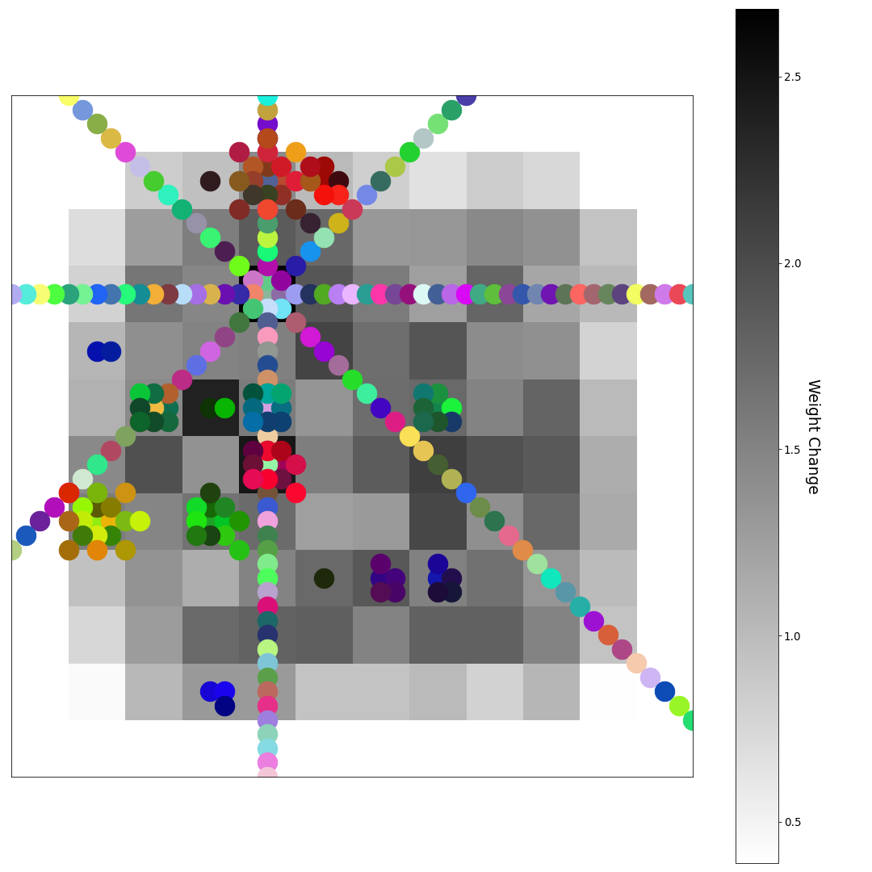
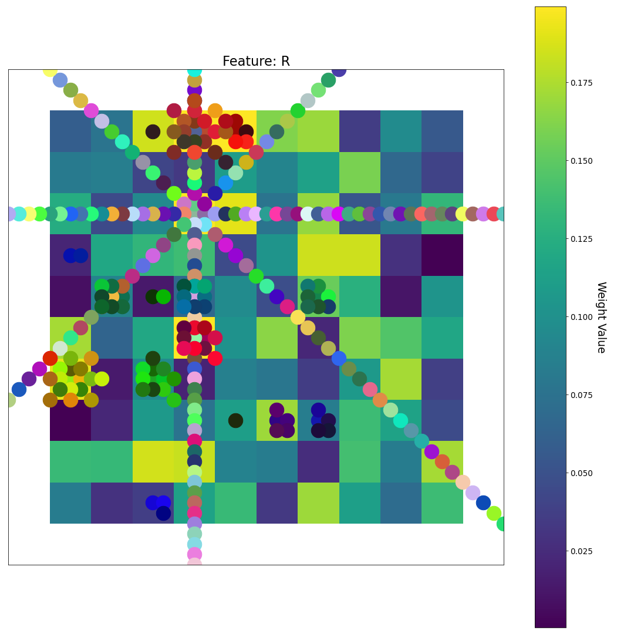
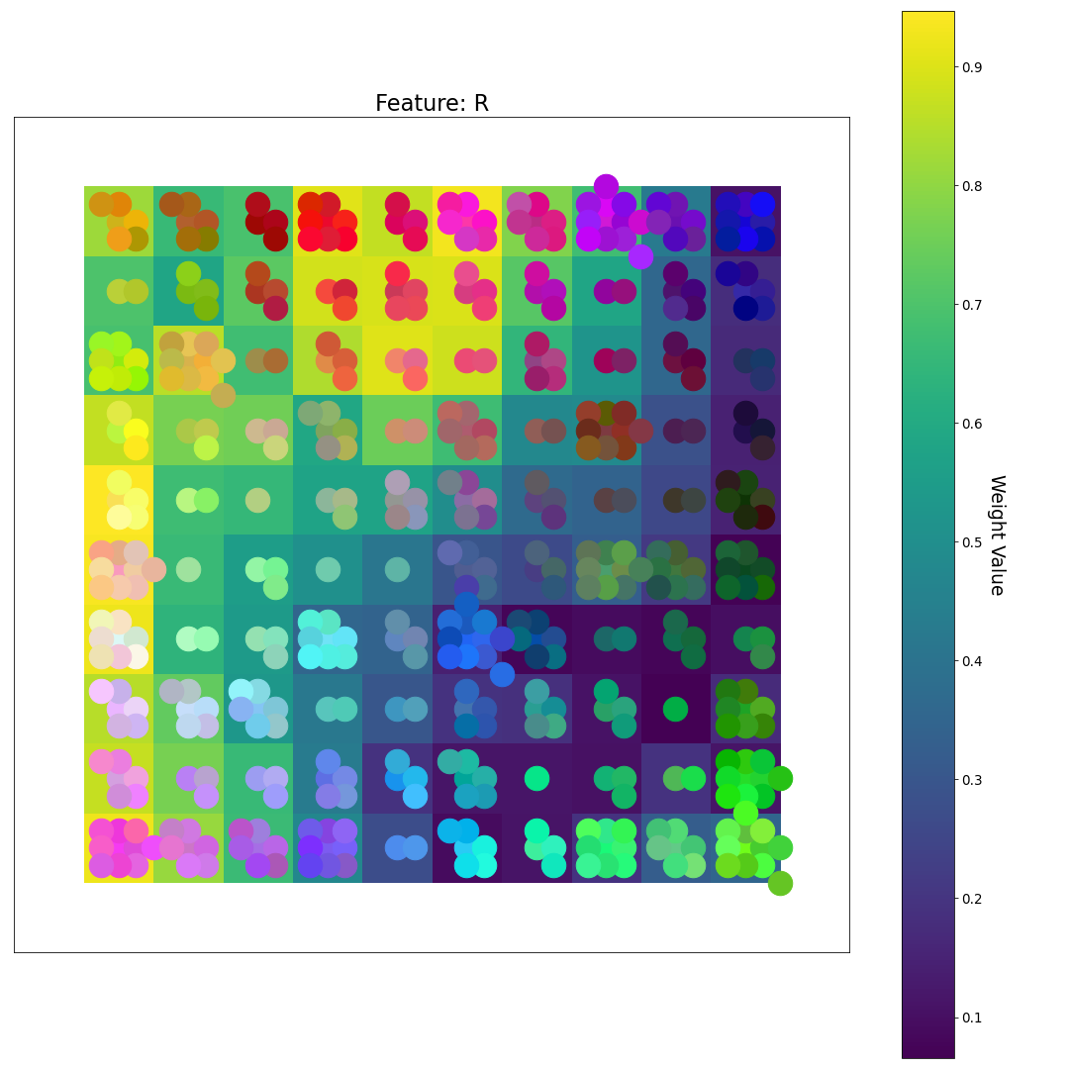
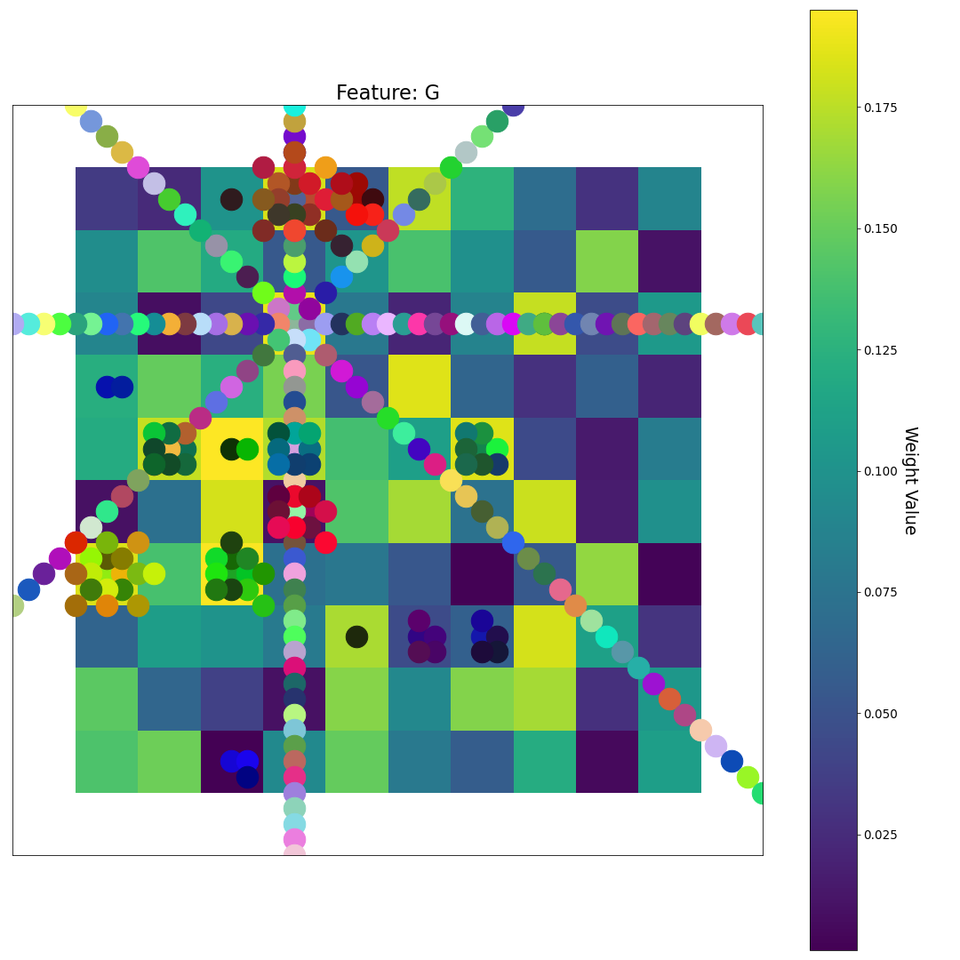
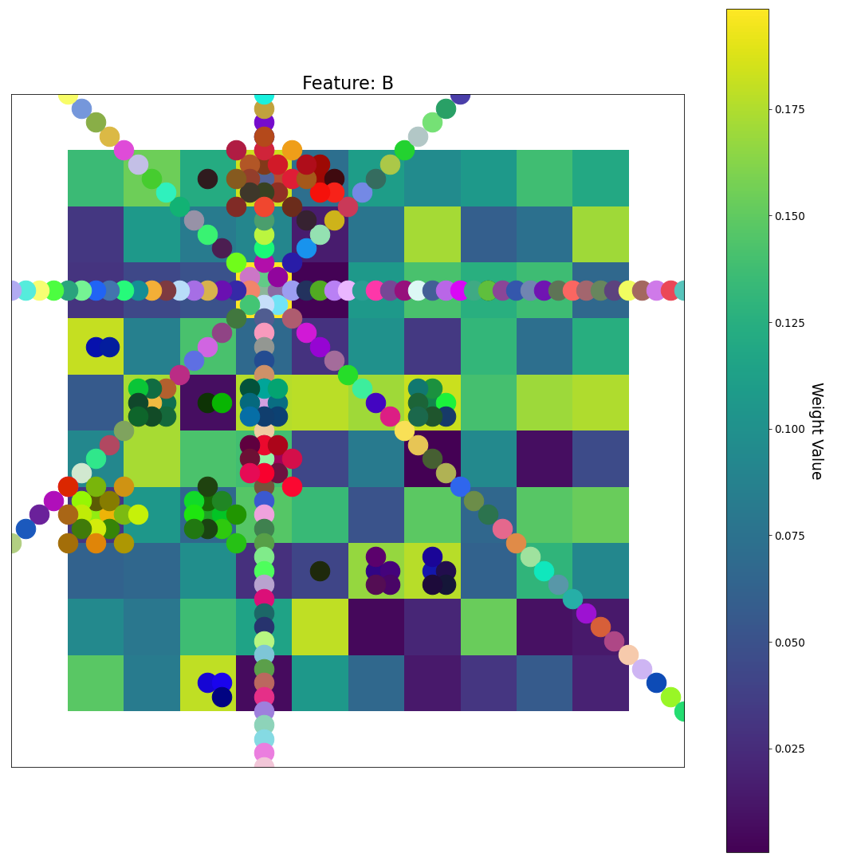
After 0 Epochs (random weights)
R
The Feature Plane backgrounds show the actual weight values for a particular feature (variable). For example, a yellow node on the R plane indicates a high R-value for that node. Therefore, that node will be more likely to be the BMU for a point that has a lot of red
U-matrix
G
Feature Plane Weight Value
B
The U-matrix background shows how similar a node is to its neighbors:
Light = very similar
Dark = Very different

Slide 3
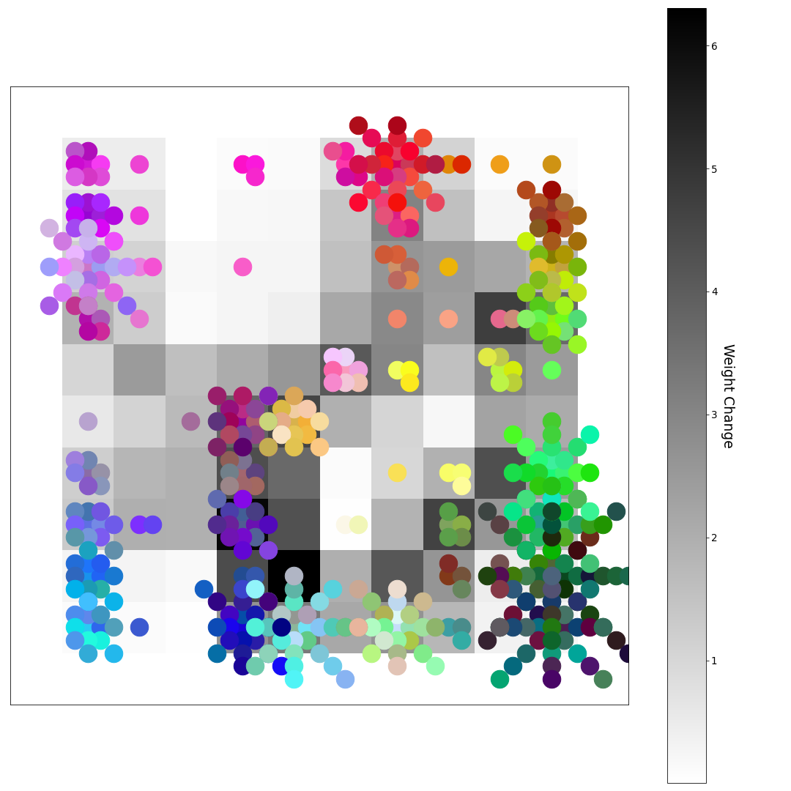
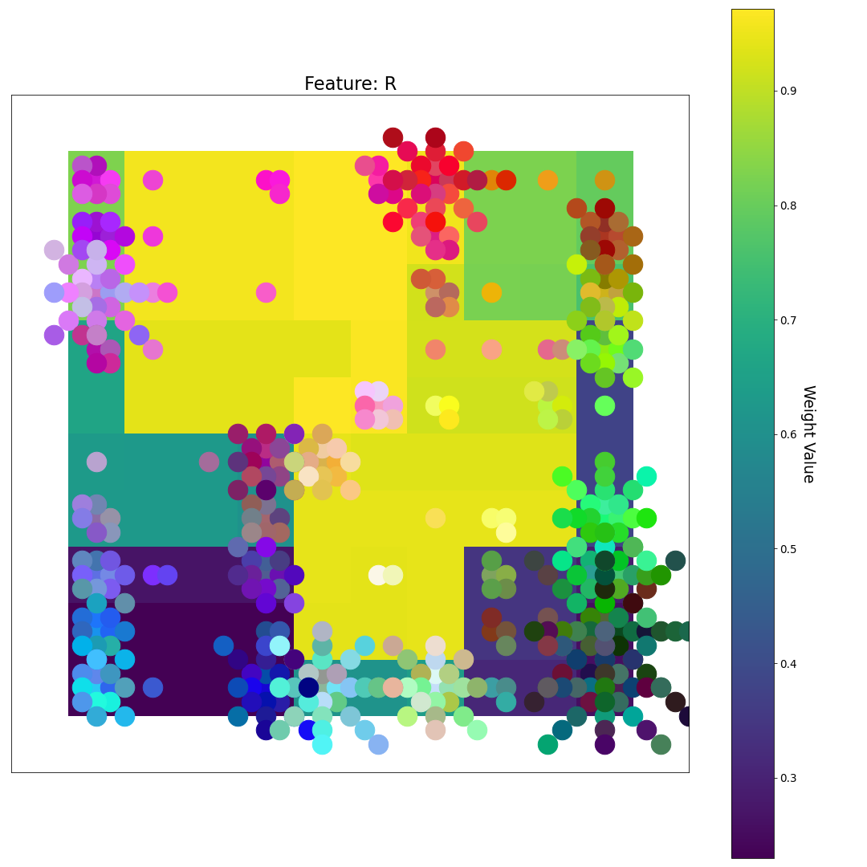
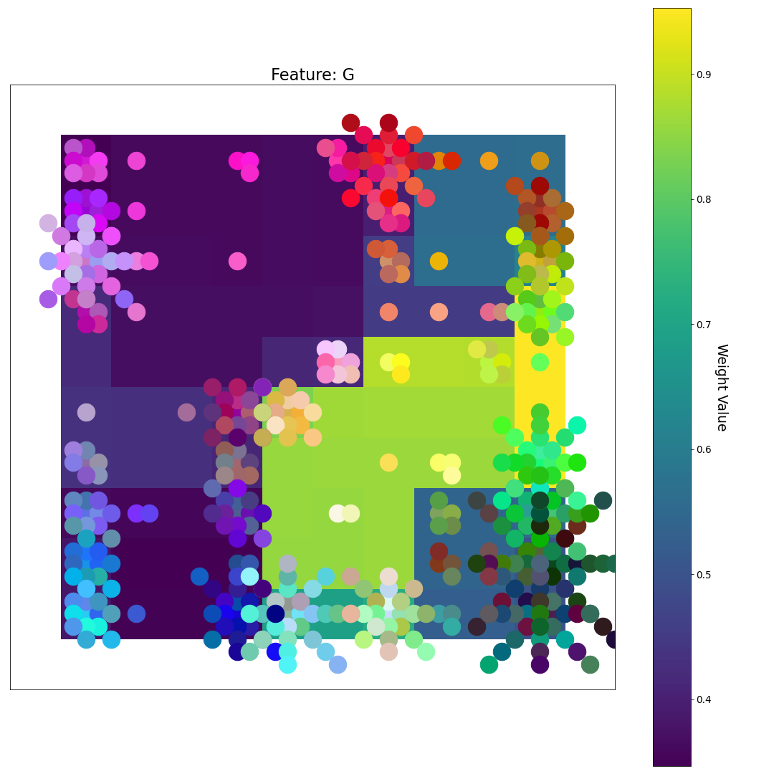
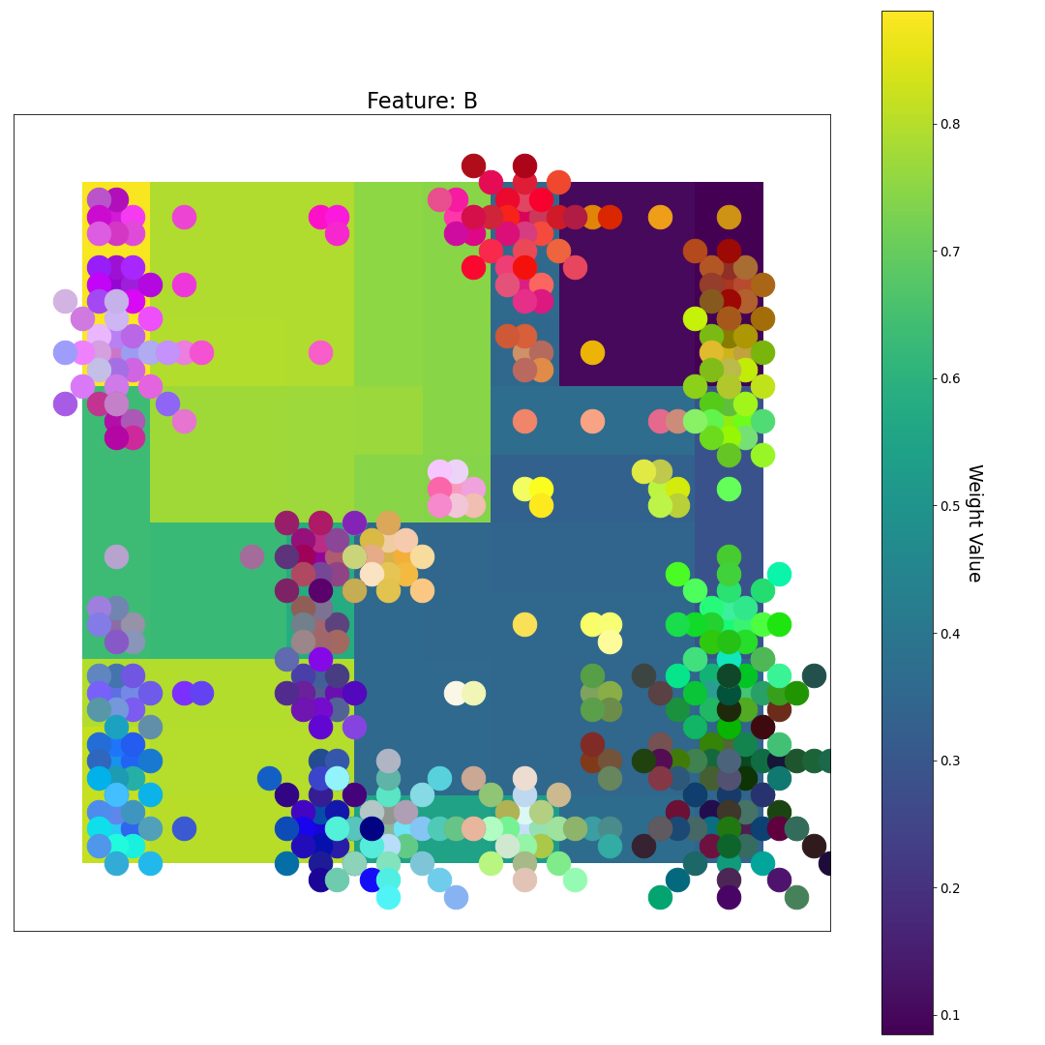
After 1 Epoch
R
Note: After only 1 epoch nodes with high R values are grouped with other nodes that have high R values. The same goes for nodes with high G and B values.
This results in the samples becoming coarsely grouped together
U-matrix
G
Feature Plane Weight Value
B

Slide 4
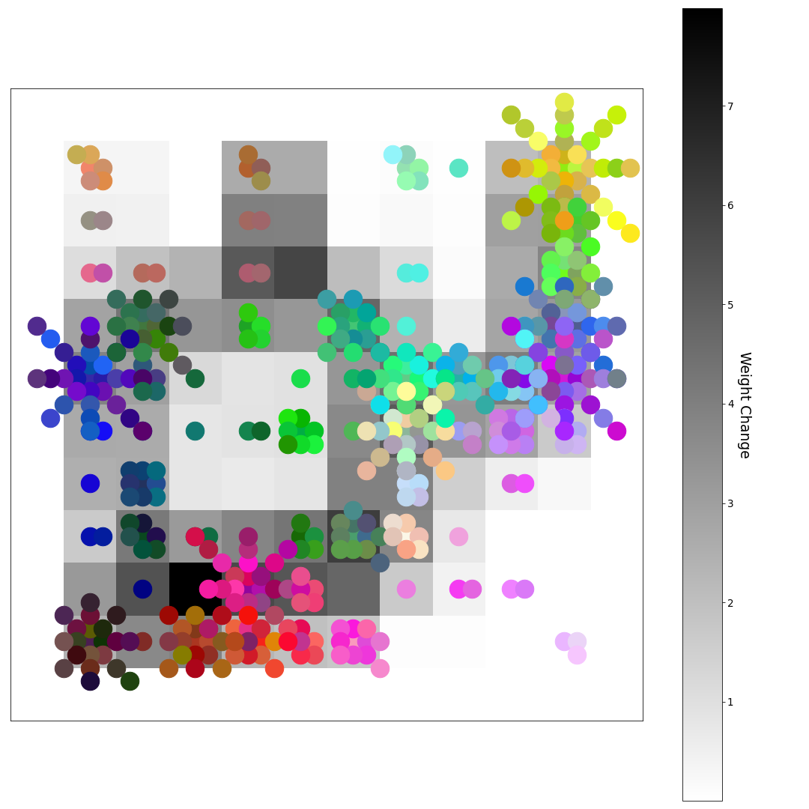
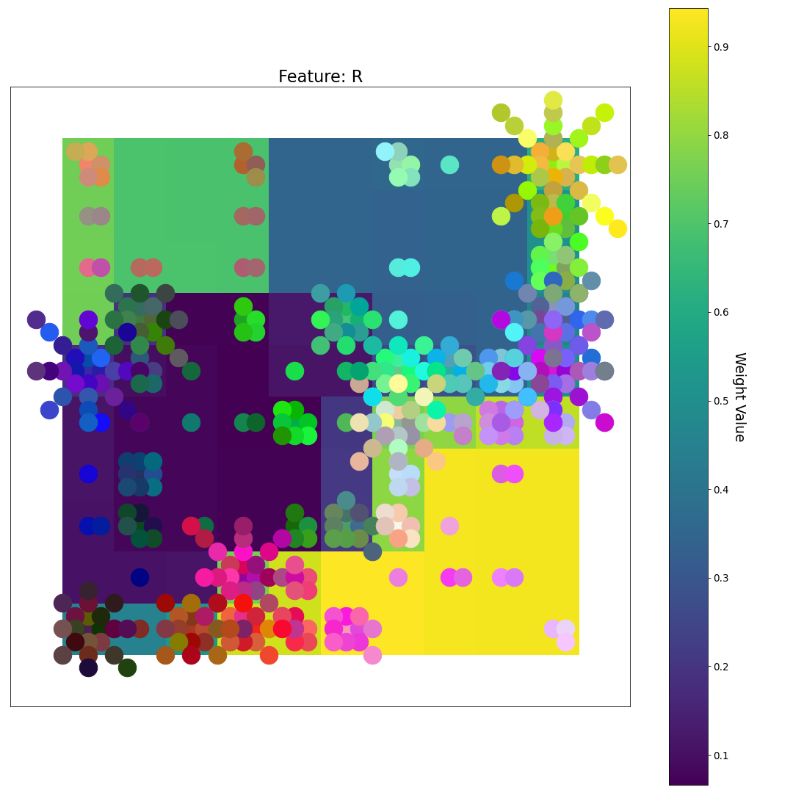
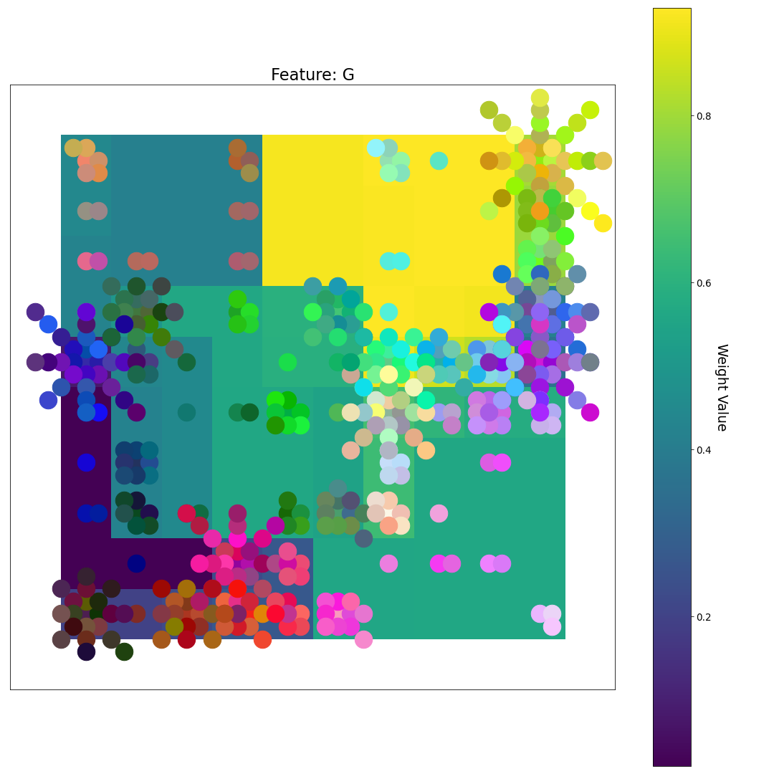
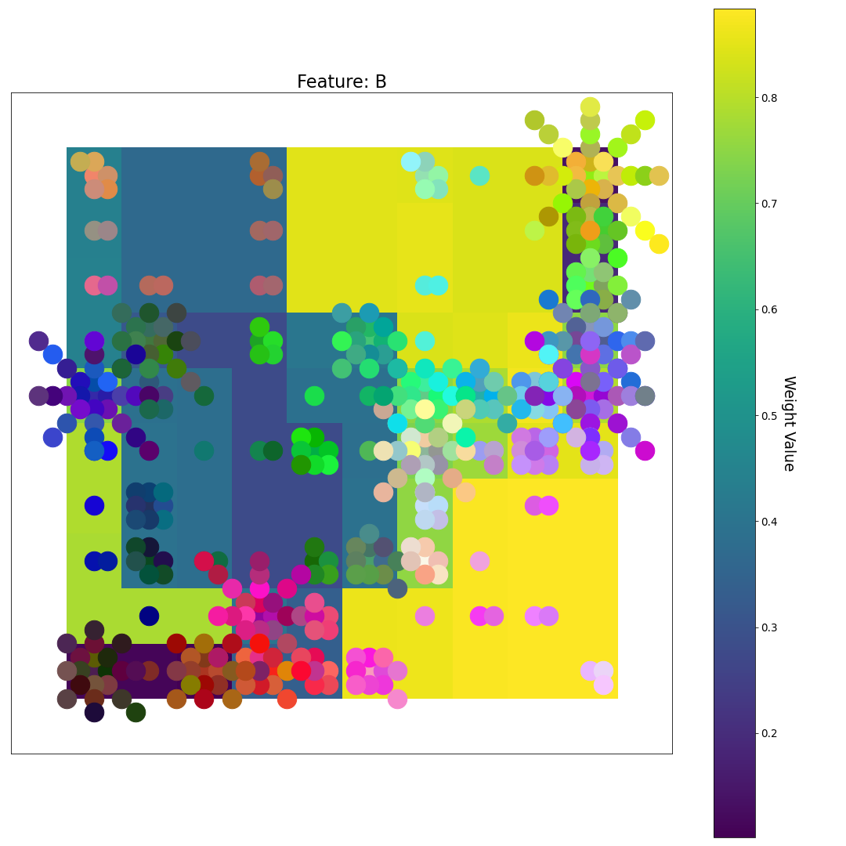
After 2 Epochs
R
U-matrix
G
Feature Plane Weight Value
B

Slide 5
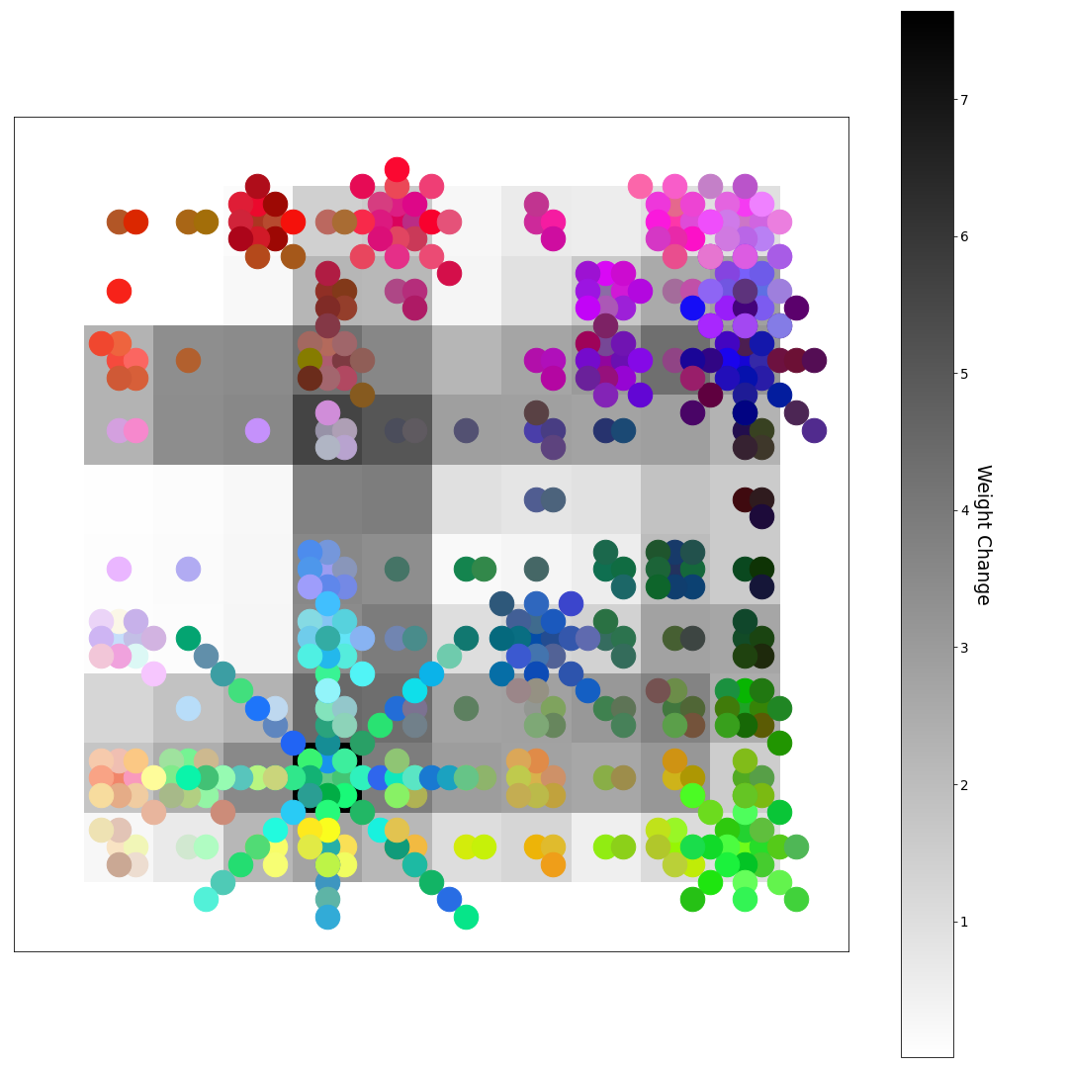
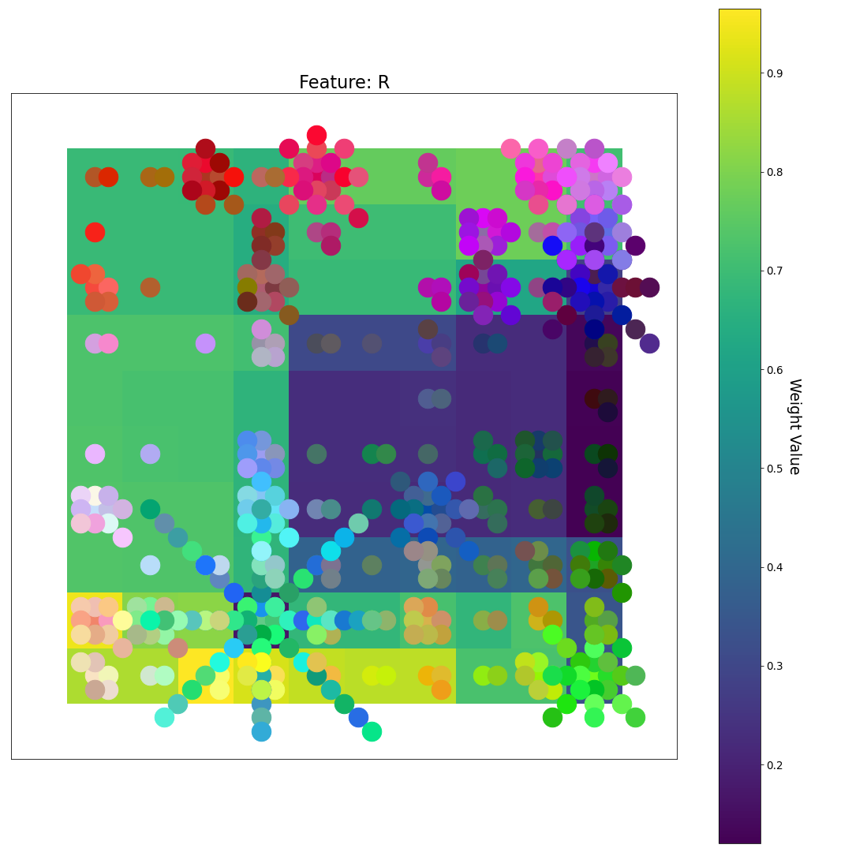
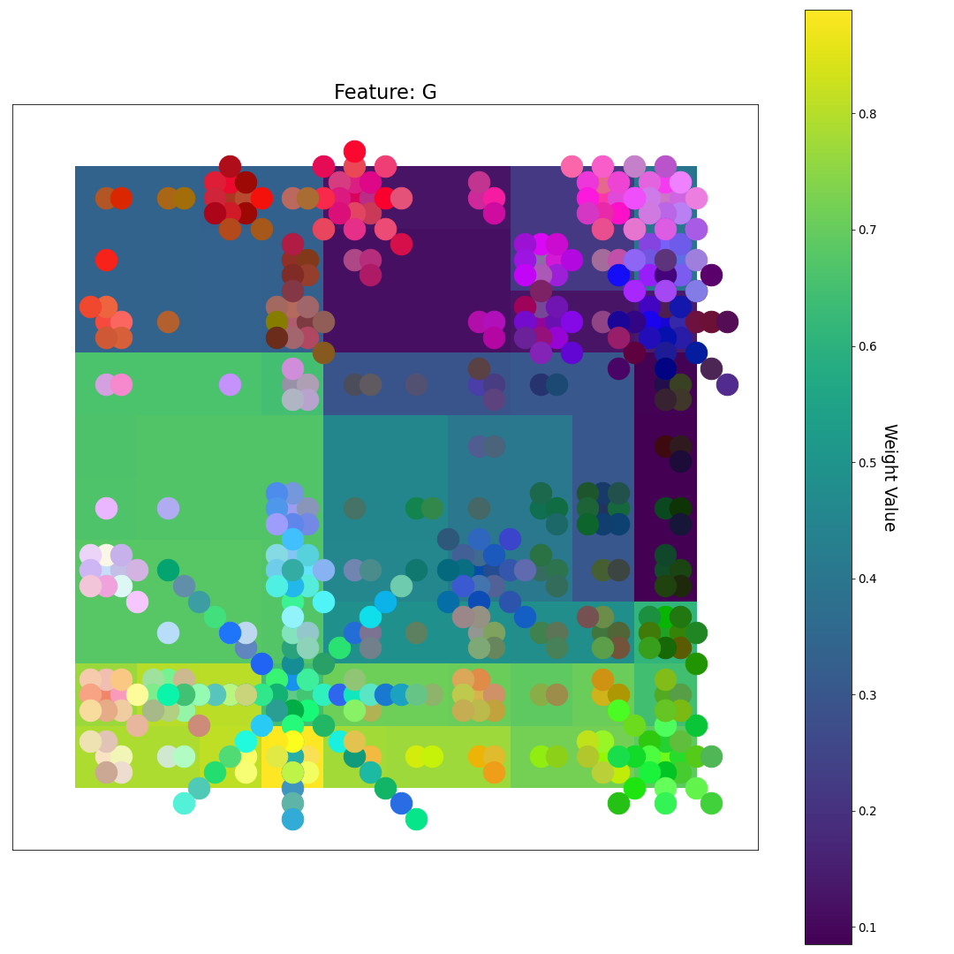
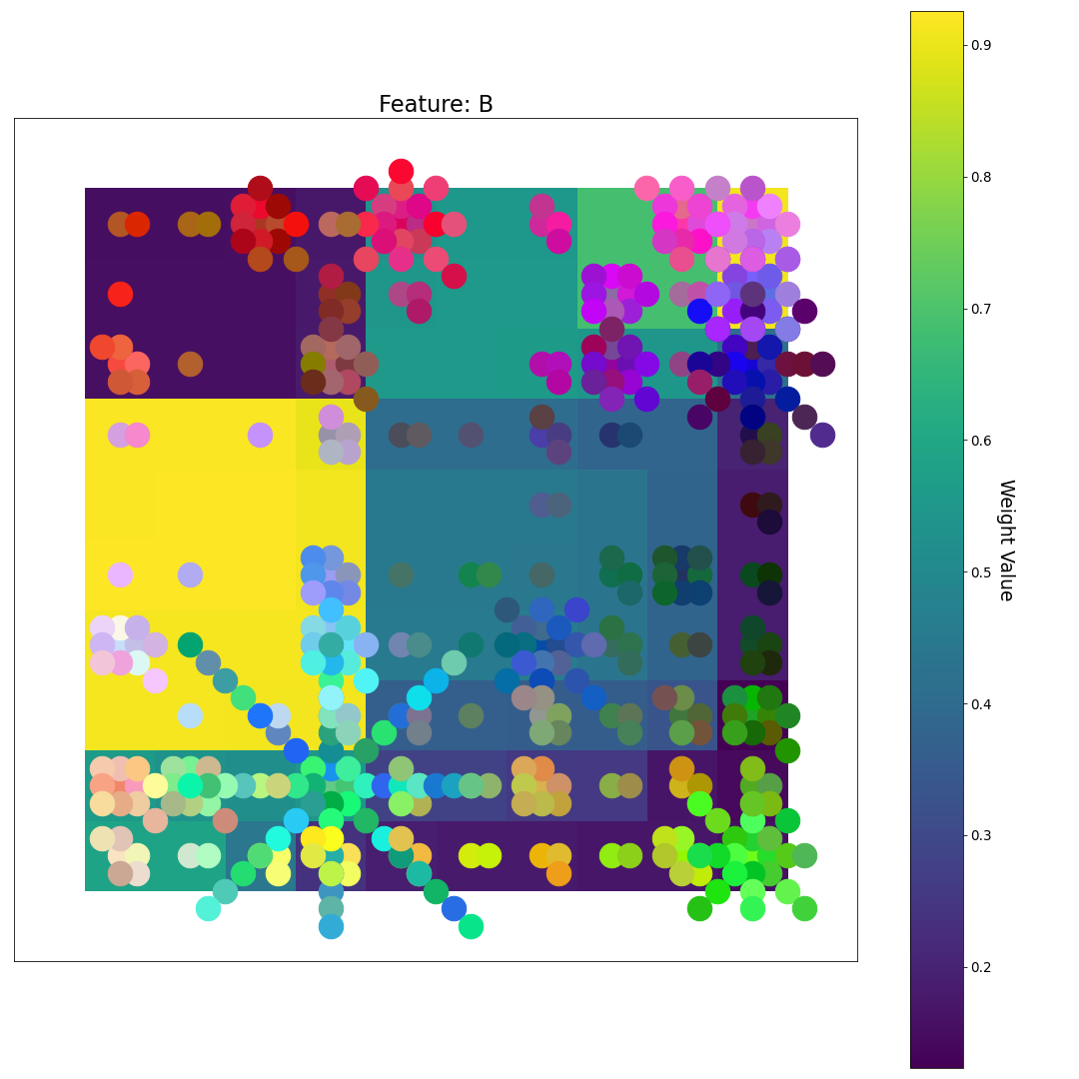
After 3 Epochs
R
U-matrix
G
Feature Plane Weight Value
B

Slide 6
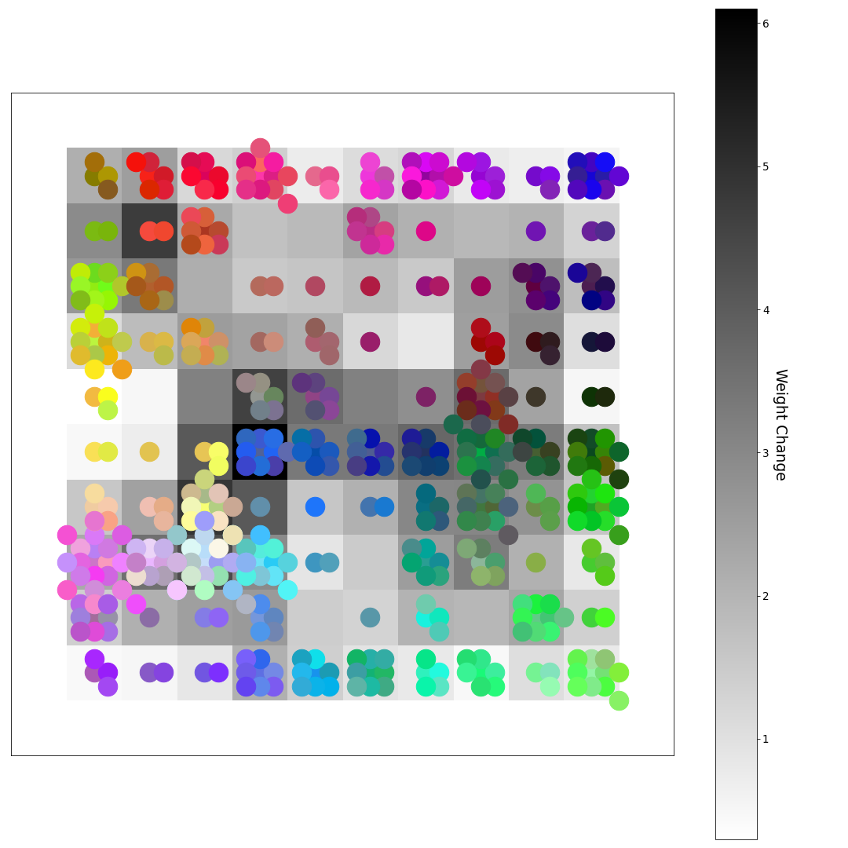
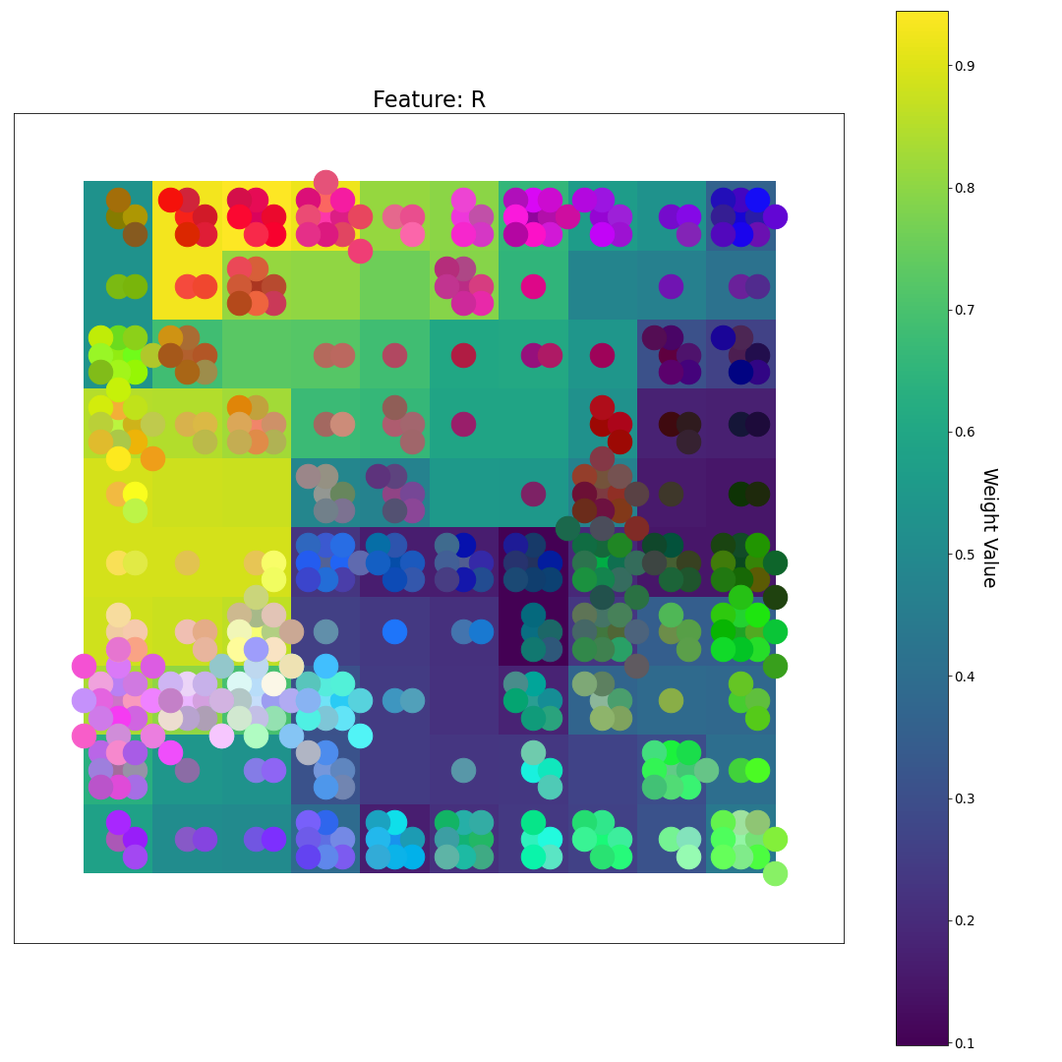
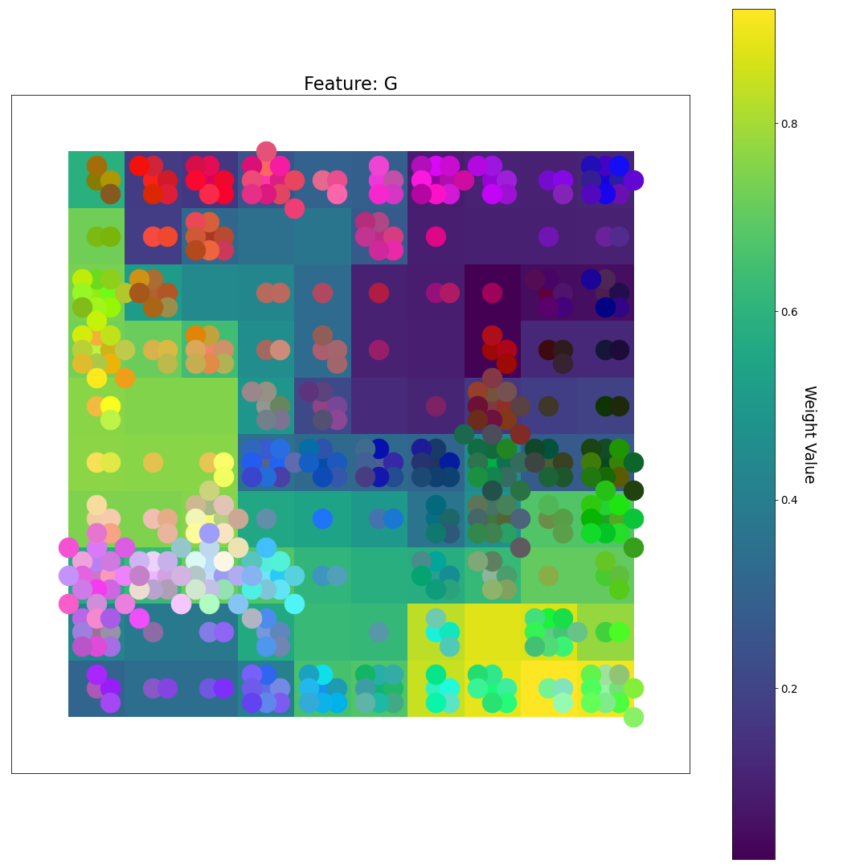
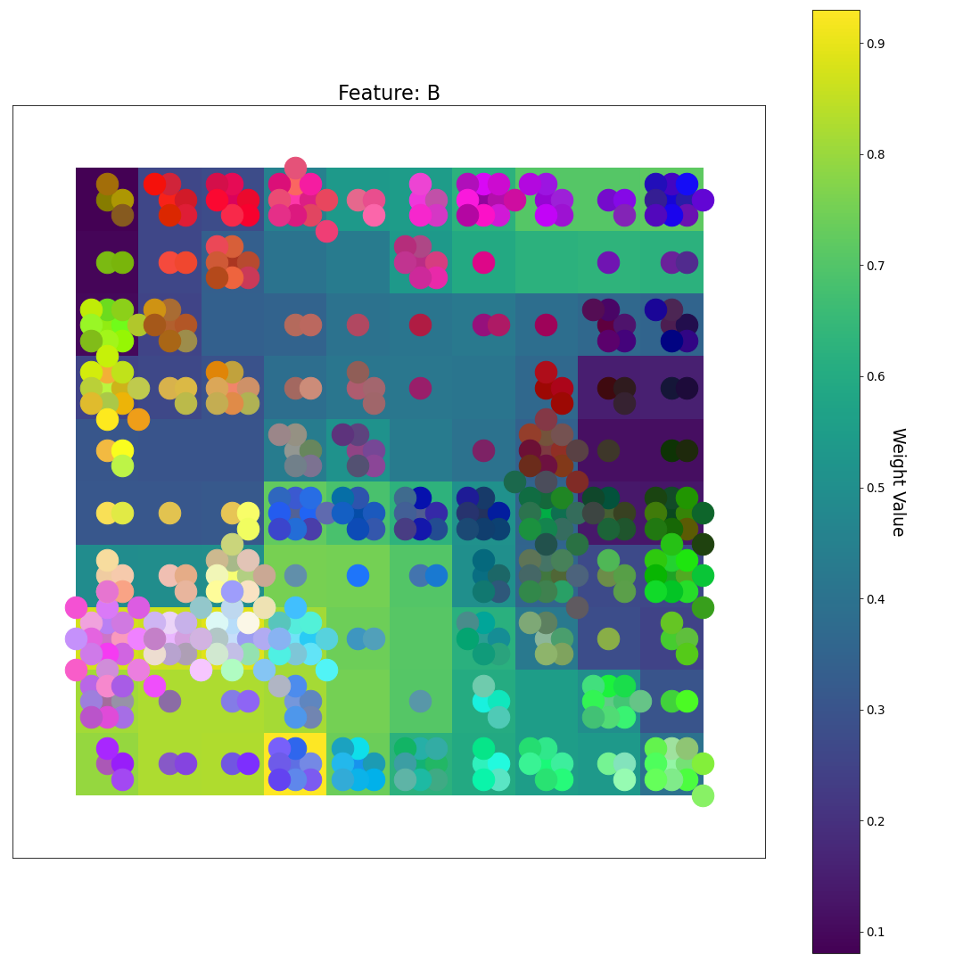
After 4 Epochs
R
After about 4 epochs, the weights are mostly “untangled”; the network has “decided” where the regions of high R, G, and B values will be located on the grid and the samples are much more evenly spread out
U-matrix
G
Feature Plane Weight Value
B

Slide 7
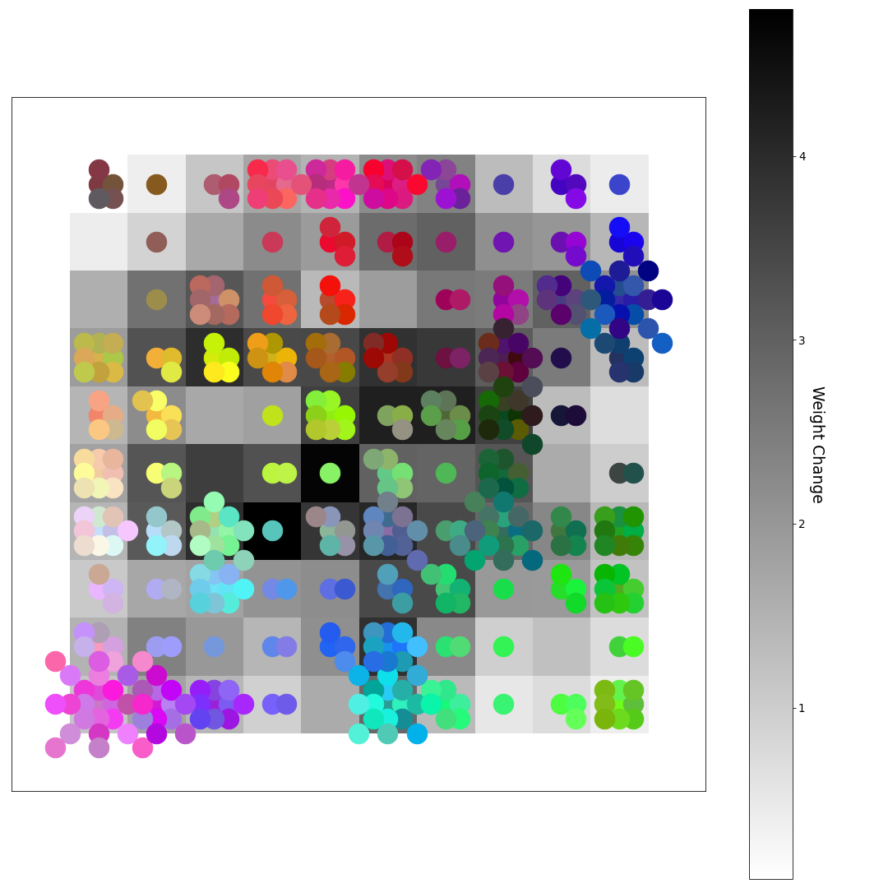
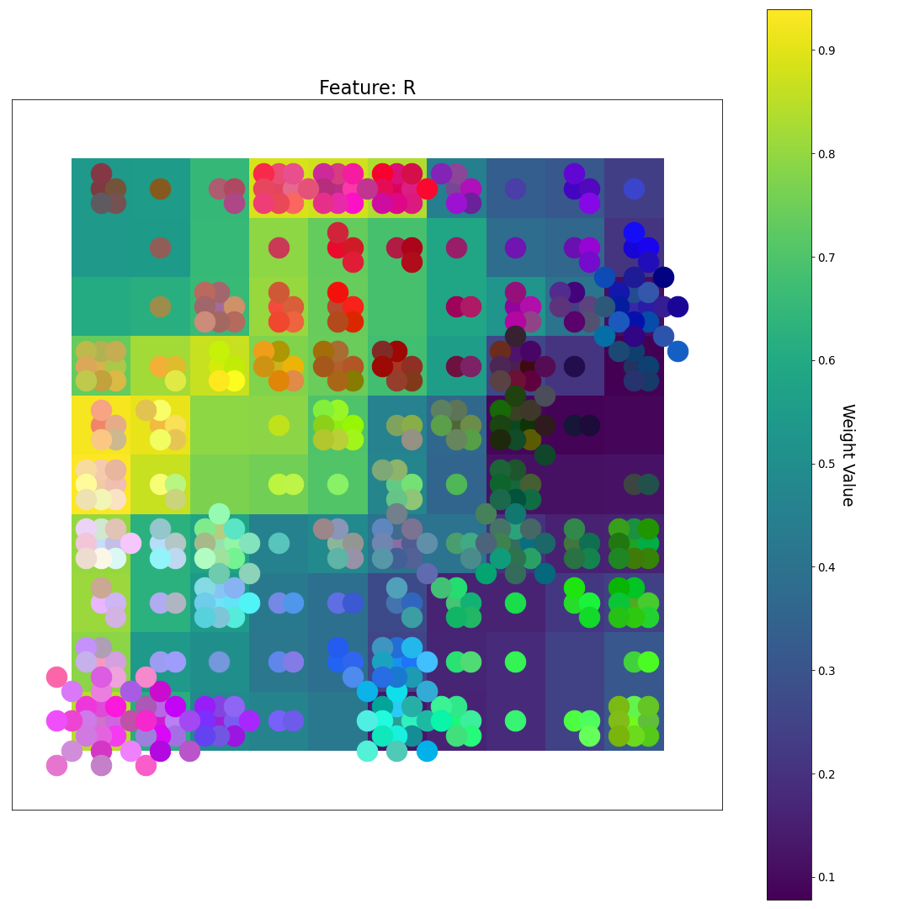
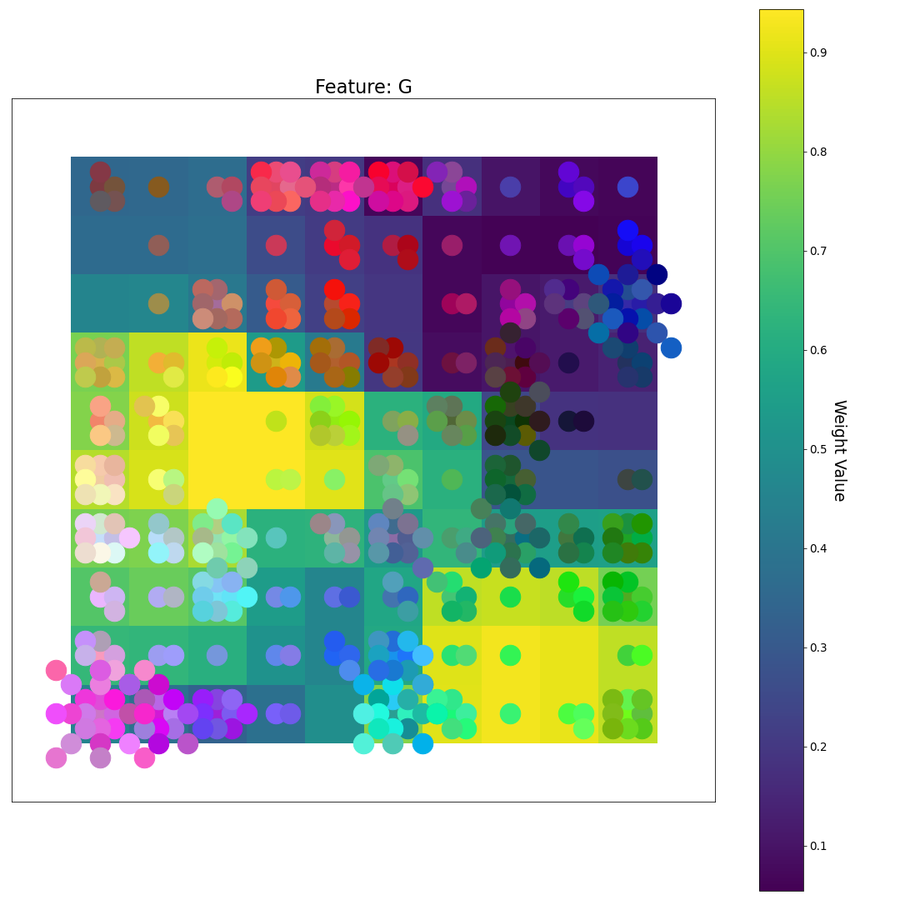
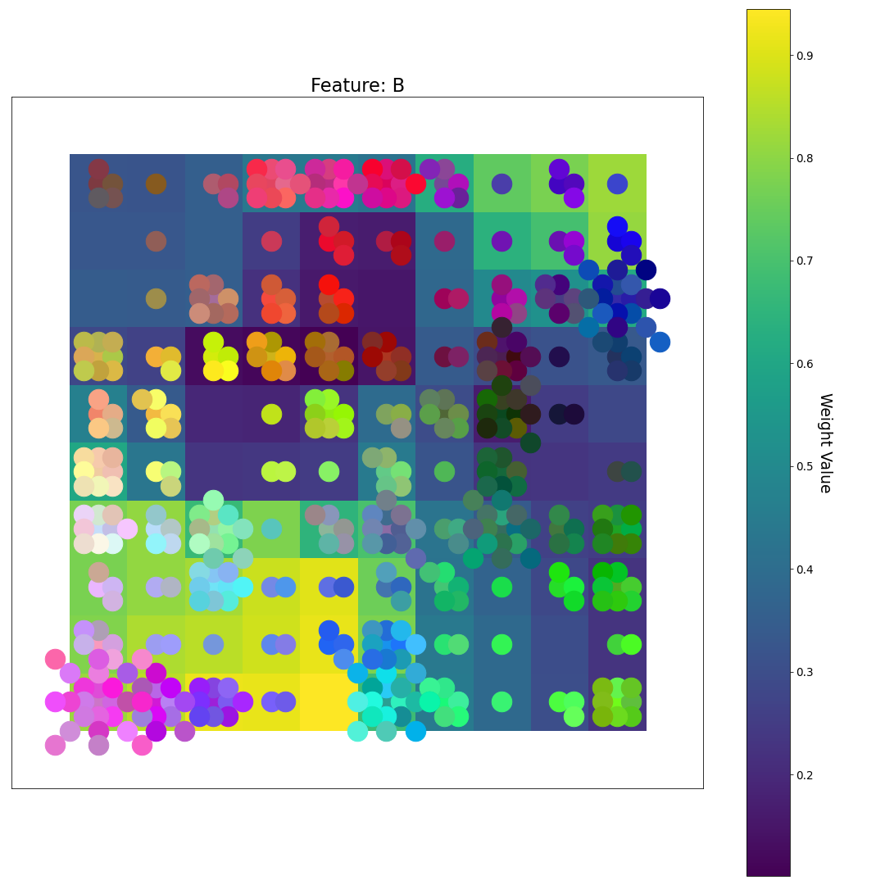
After 5 Epochs
R
U-matrix
G
Feature Plane Weight Value
B

Slide 8
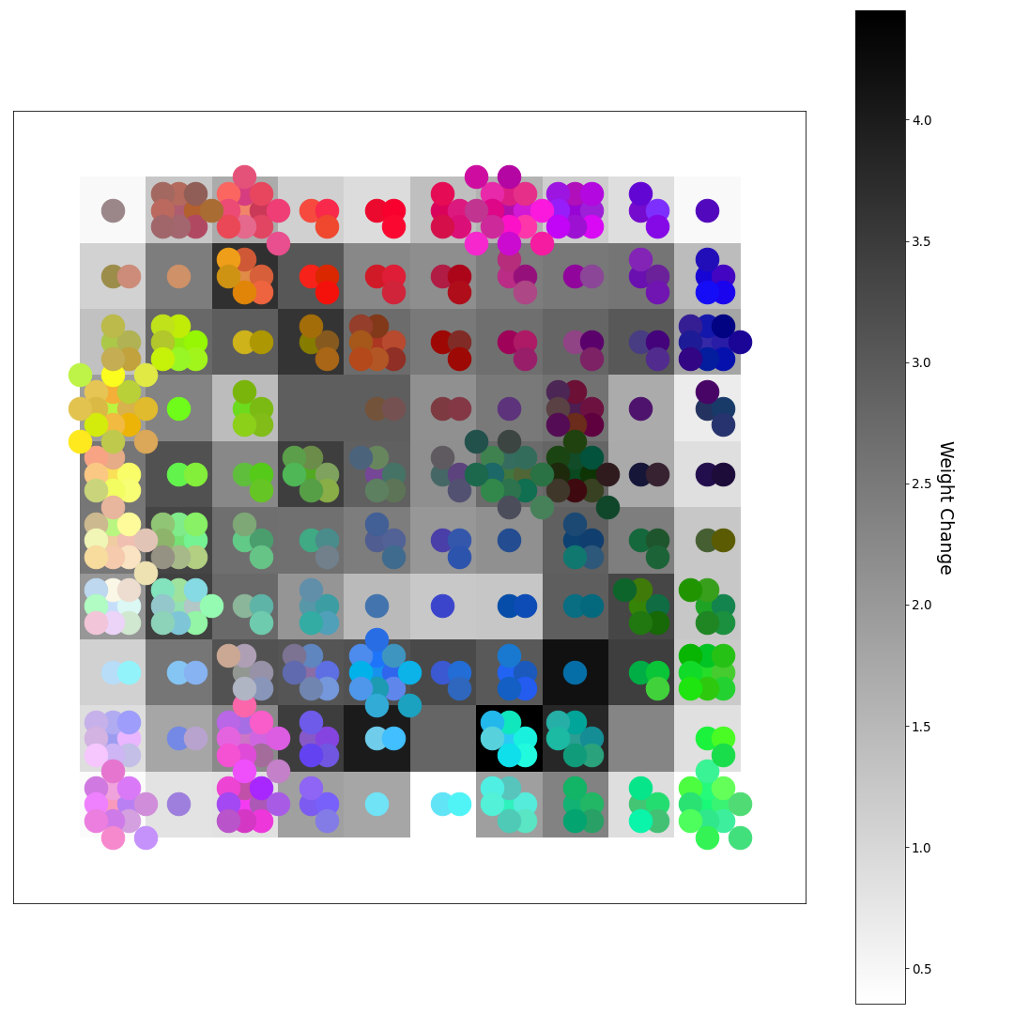
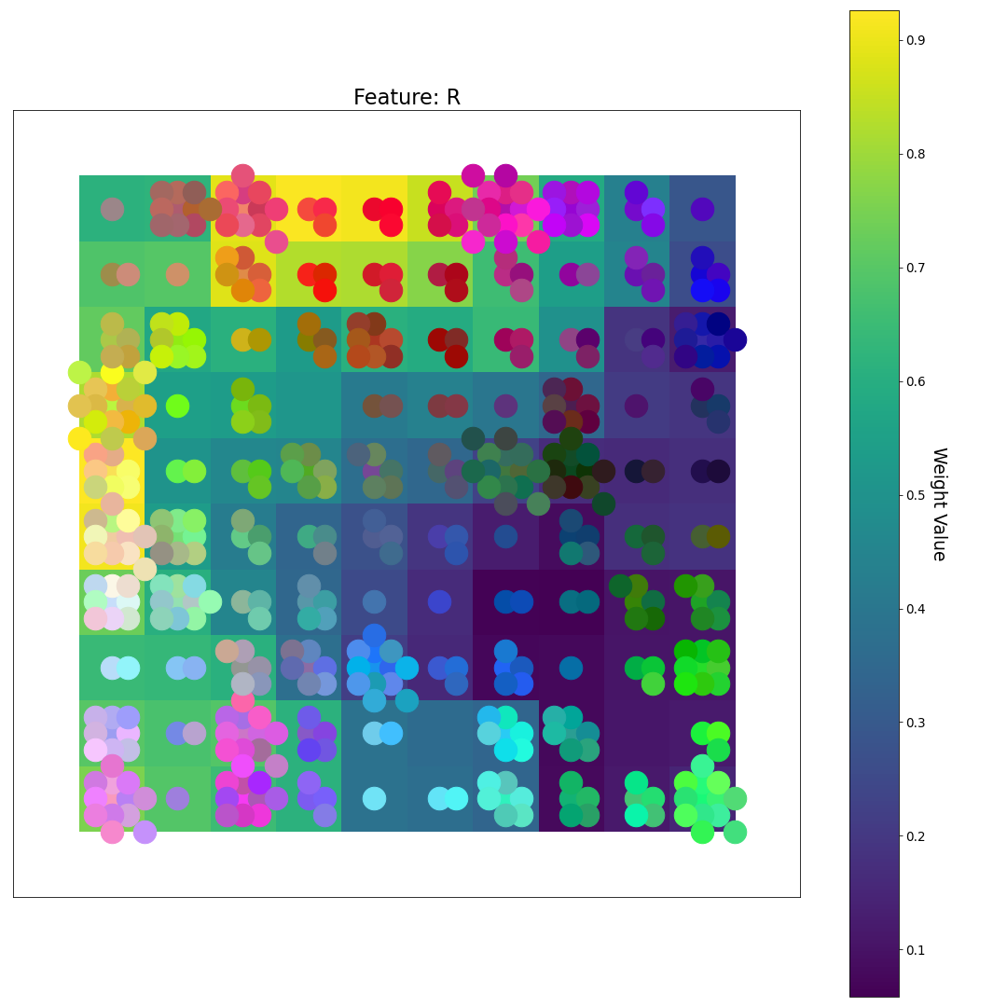
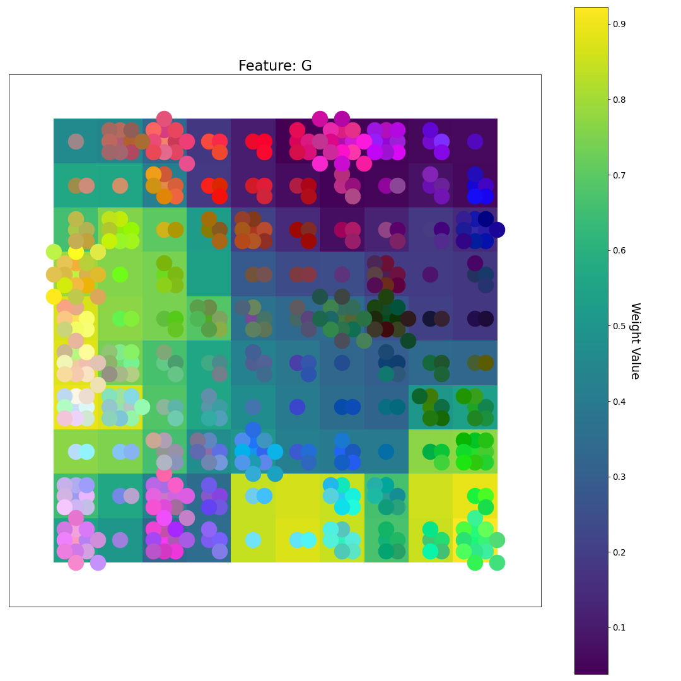
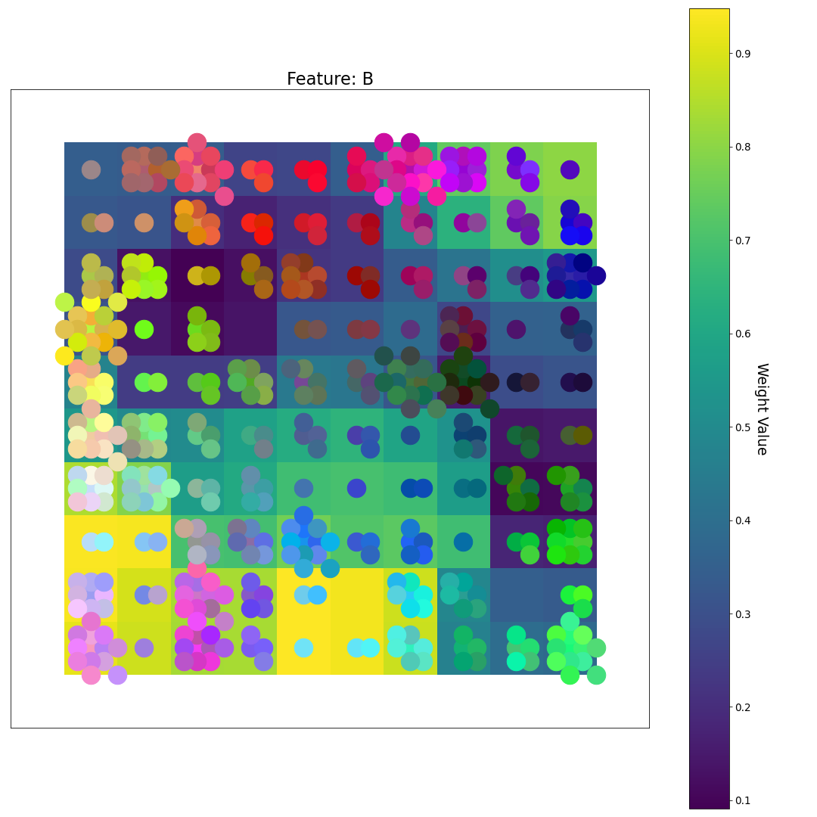
After 6 Epochs
R
U-matrix
G
Feature Plane Weight Value
B

Slide 9
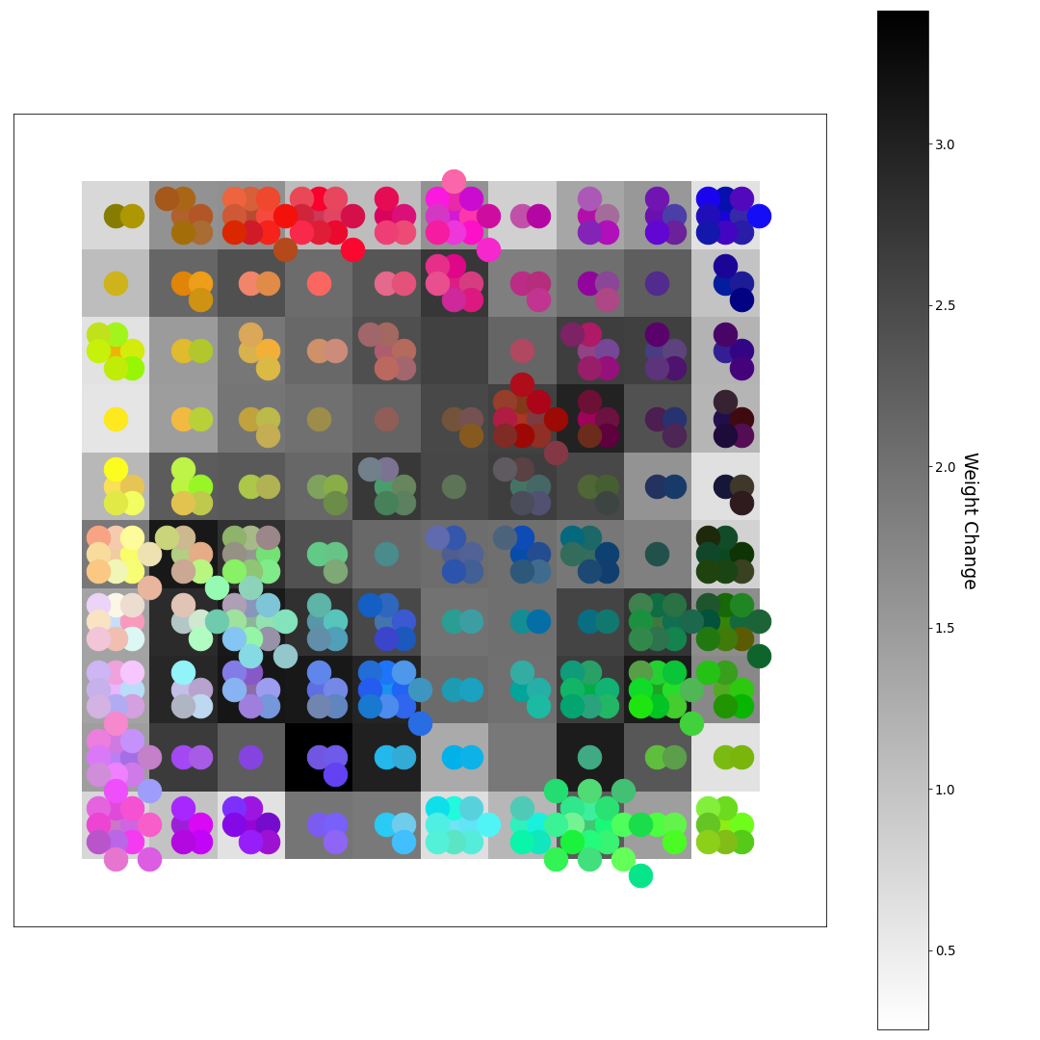
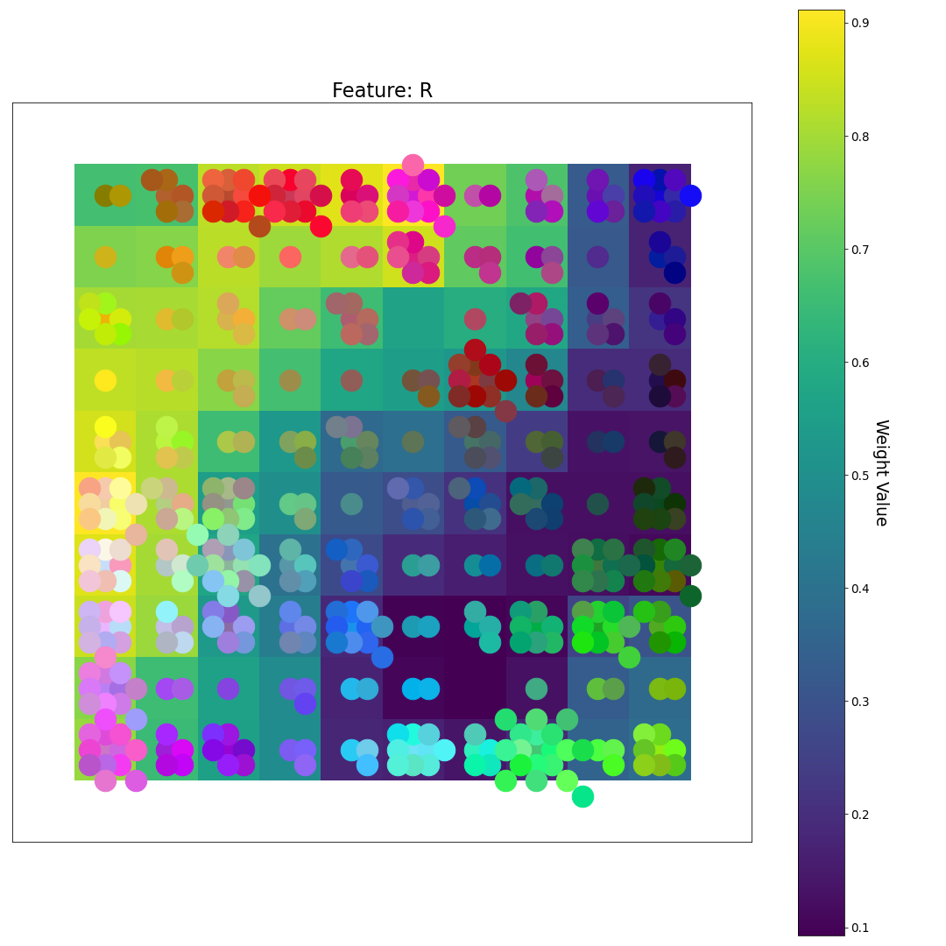
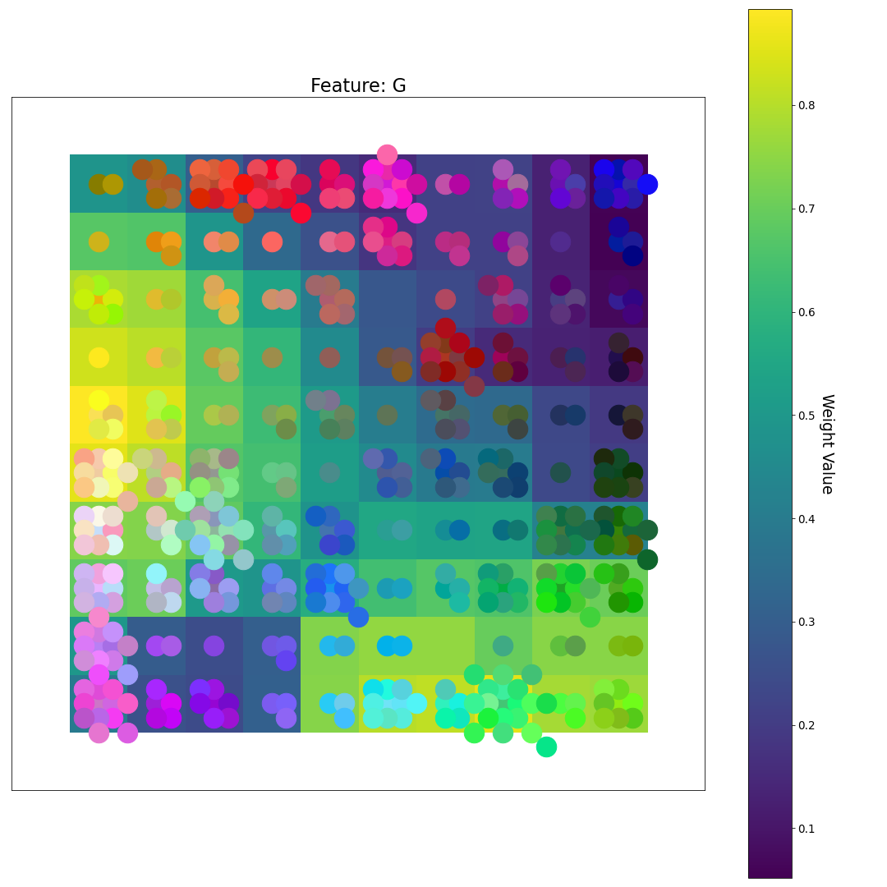
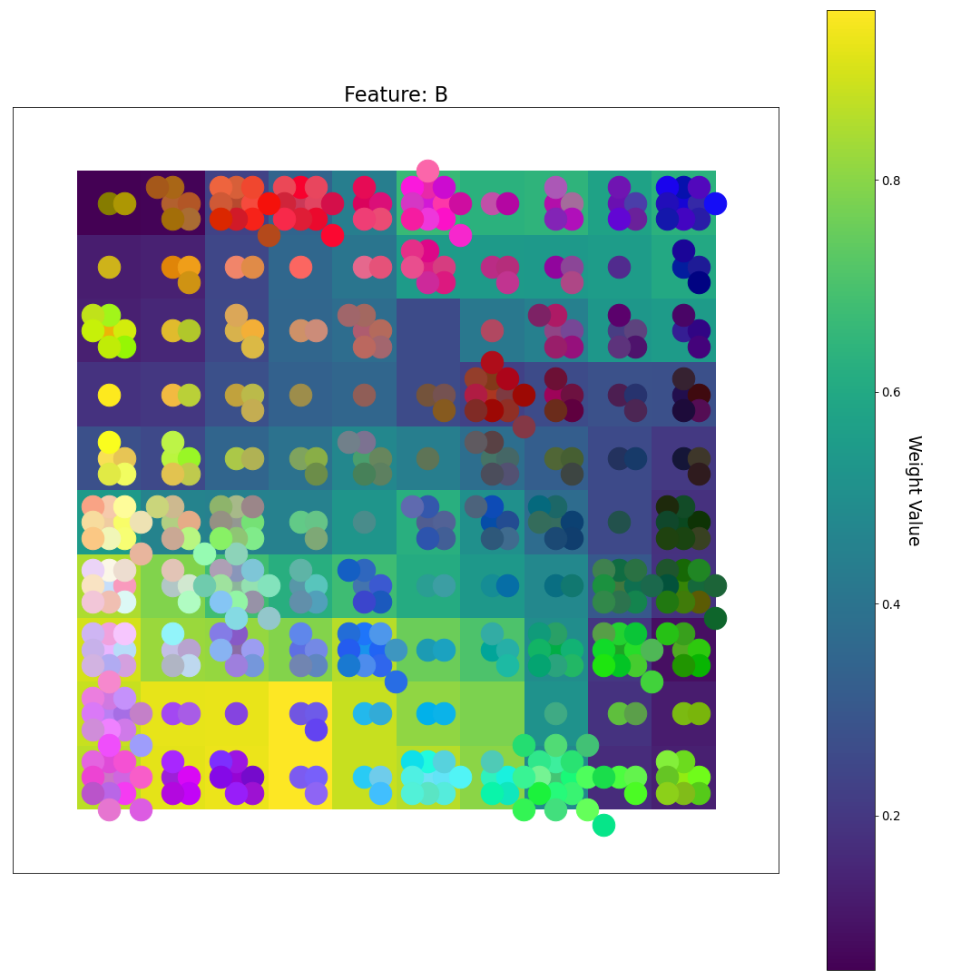
After 7 Epochs
R
U-matrix
G
Feature Plane Weight Value
B

Slide 10
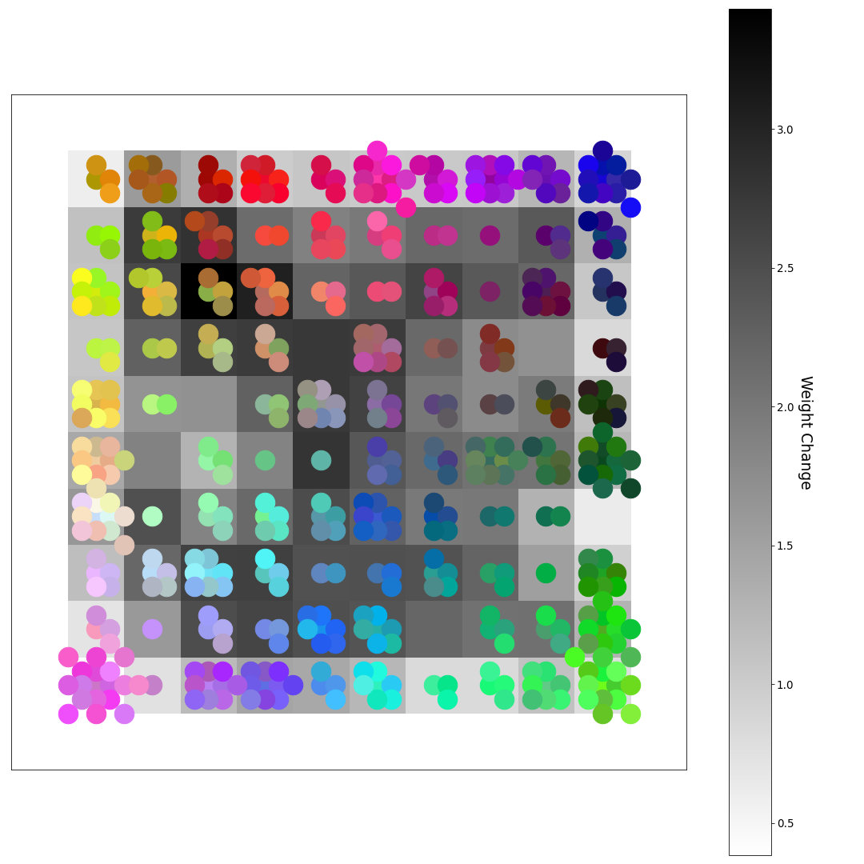
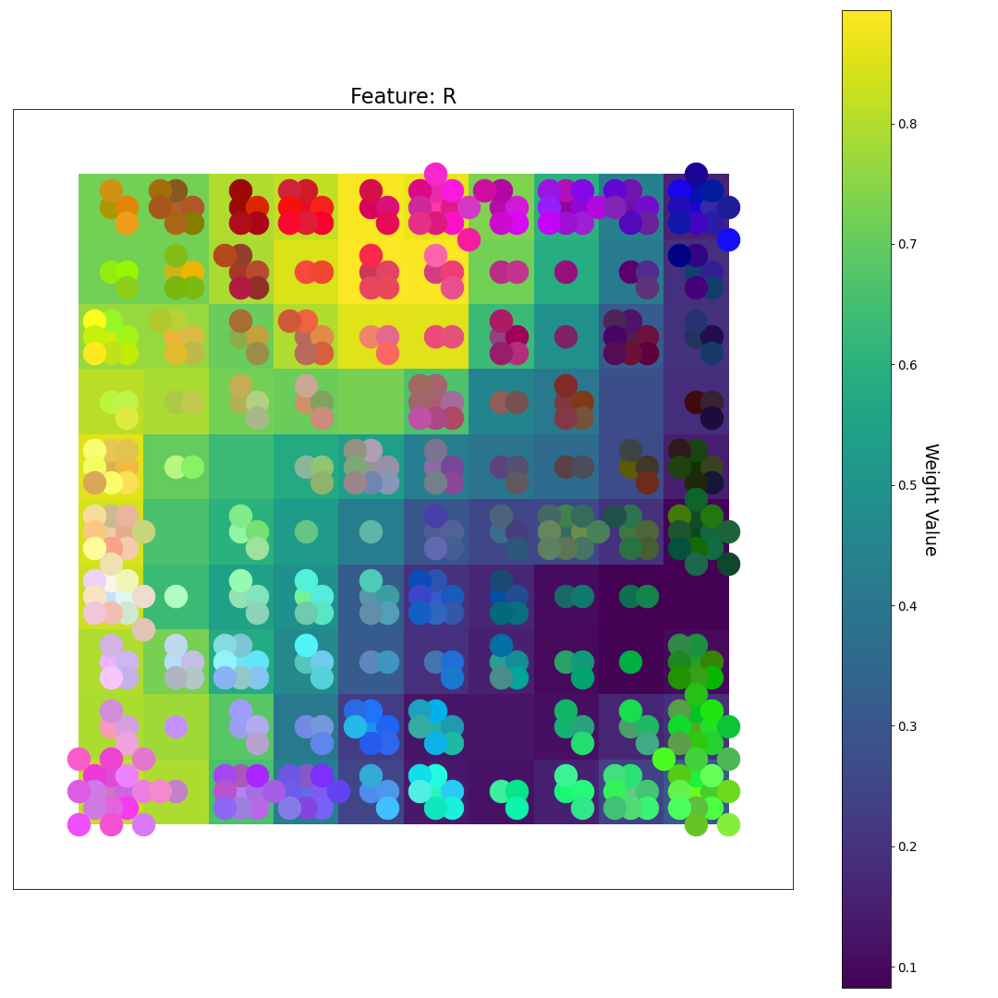
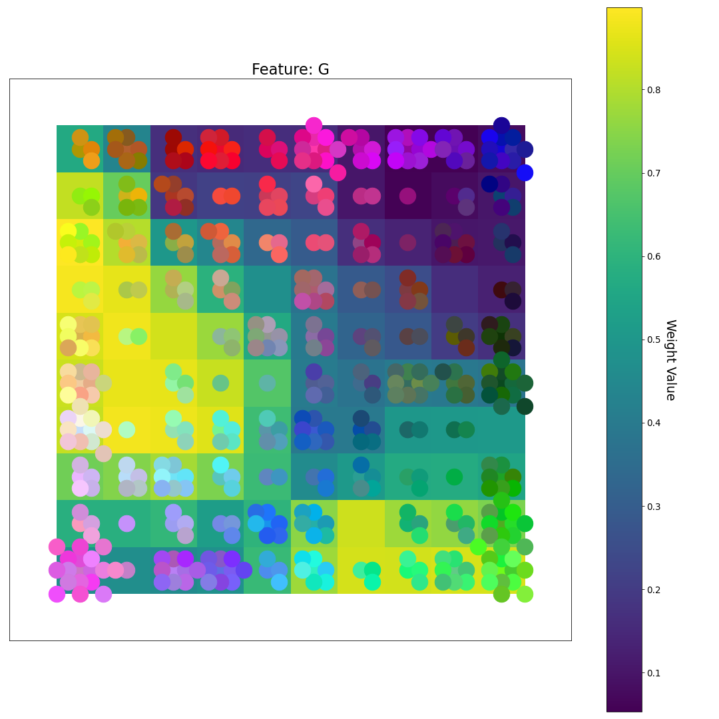
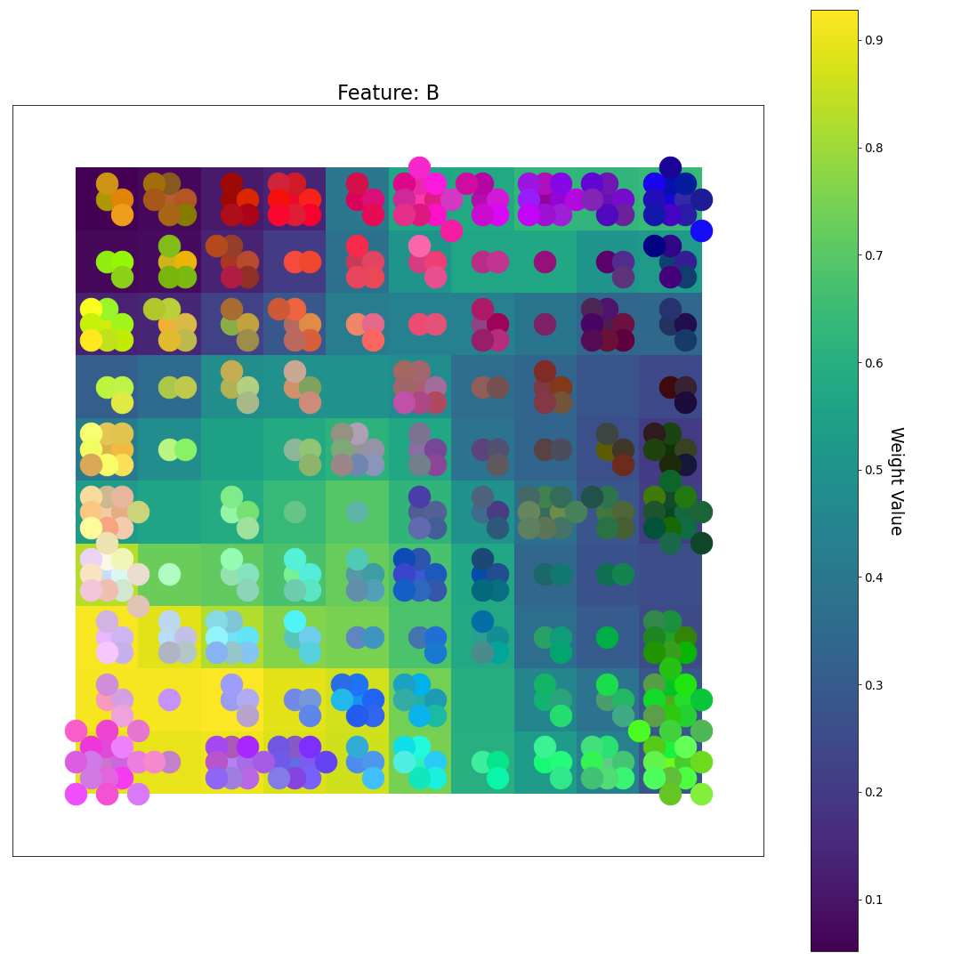
After 8 Epochs
R
As fine-tuning progresses, the weights develop more of a smooth gradient between areas of high and low values
U-matrix
G
Feature Plane Weight Value
B

Slide 11
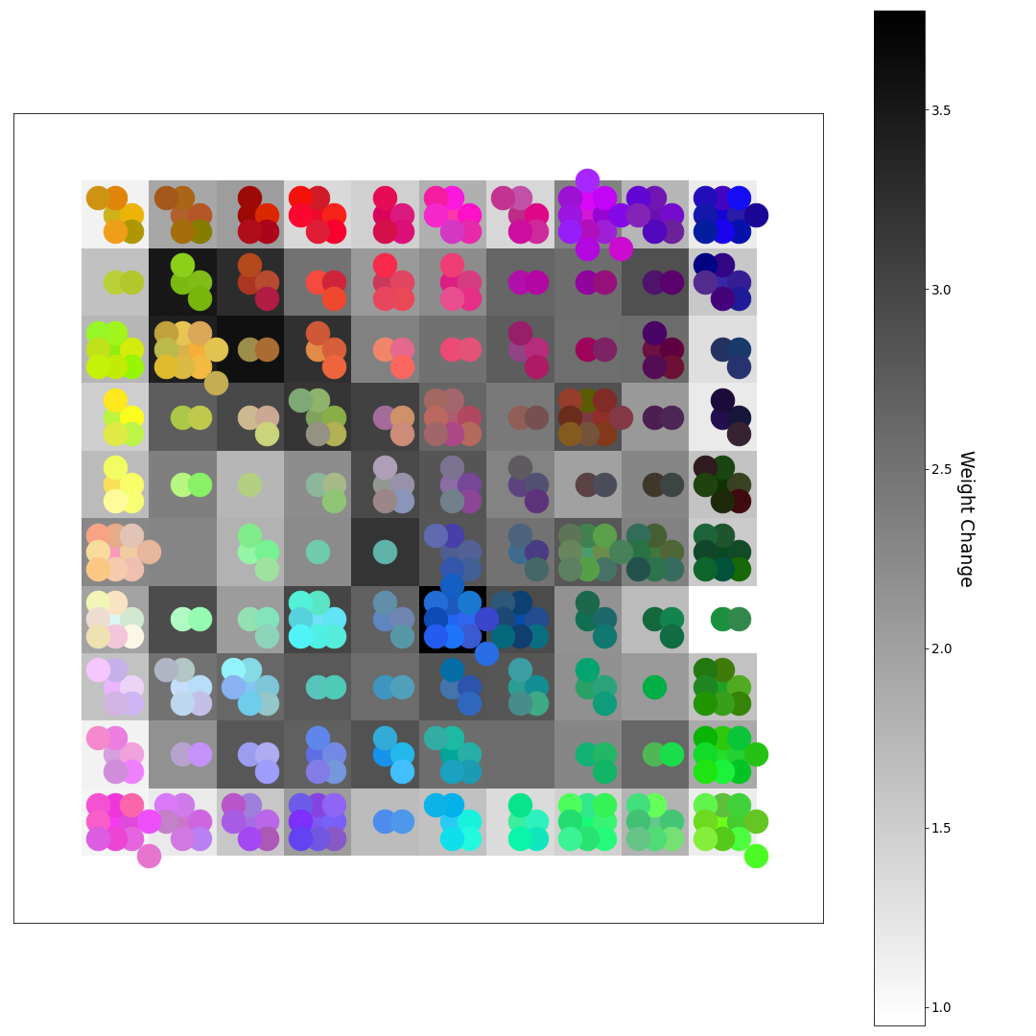

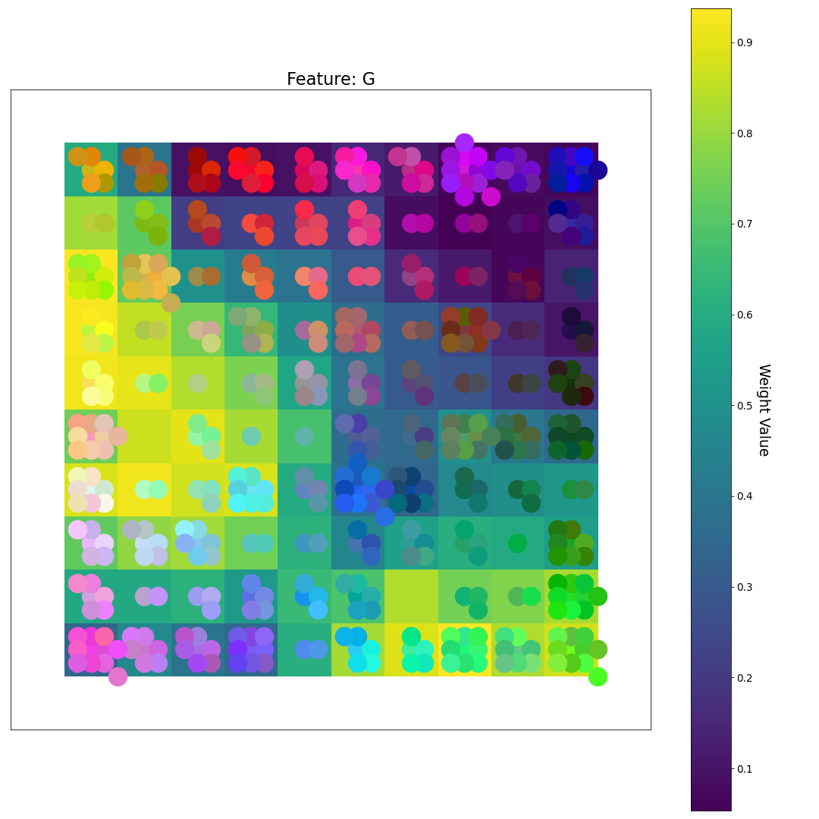
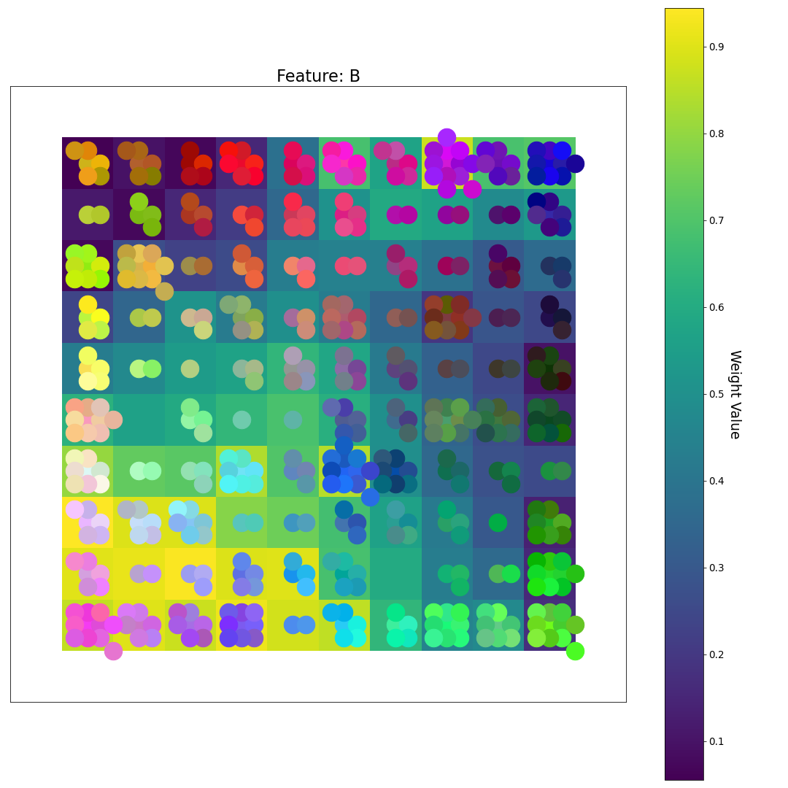
After 9 Epochs
R
U-matrix
G
Feature Plane Weight Value
B

Slide 12
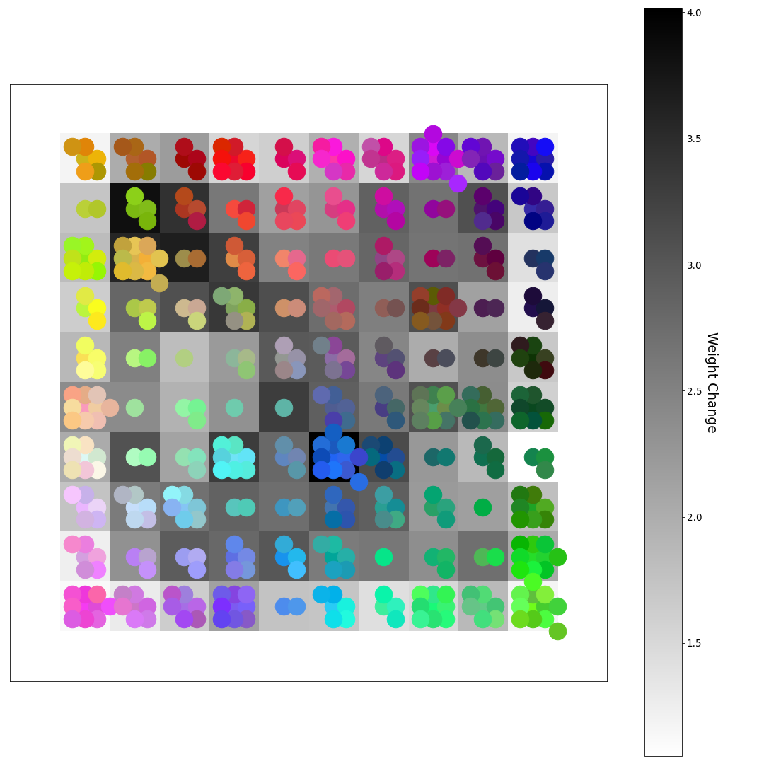

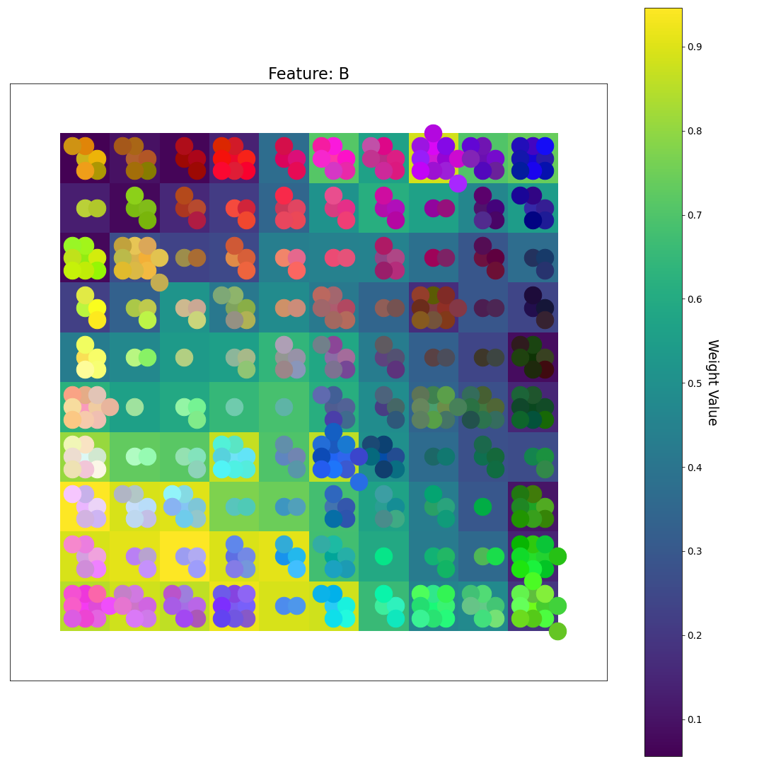
After 10 Epochs (Final Weights)
R
After 10 epochs, the samples are spread relatively evenly across the grid and are organized by both color and by brightness. Note that colors that include a lot of red are grouped over the yellow areas of the R feature plane. The same goes for green and blue.
U-matrix
G
Feature Plane Weight Value
B

